Slide 1
Seizure presentation

Slide 2
Outline
What do they look like?
Timeline - Review recent/extreme examples
Framework for theories
Go through theories – which clues are in favor/opposed?
Timeline of events
Timeline of a mouses pipeline life cycle
Possible directions
Go through every possibility and weigh any evidence

Slide 3
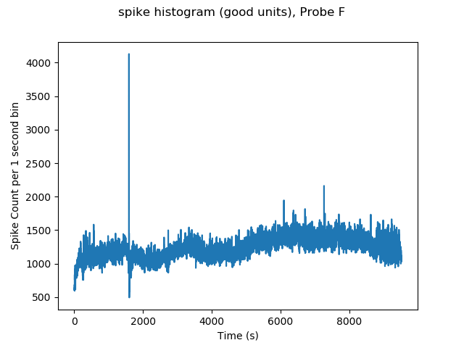
What do they look like

Slide 4
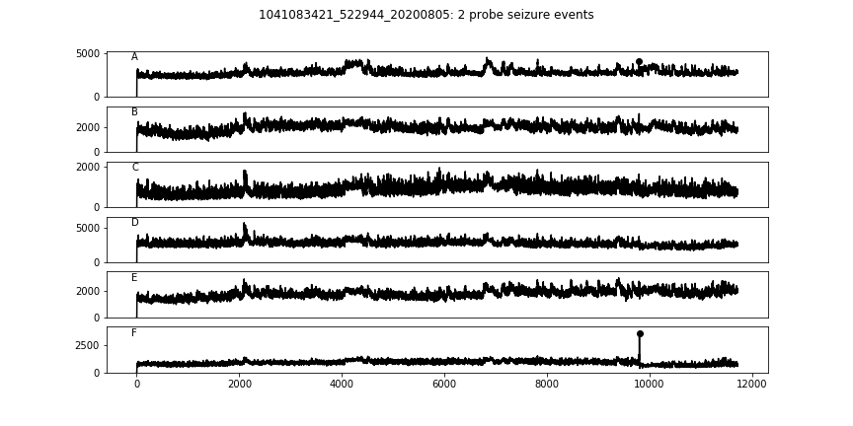
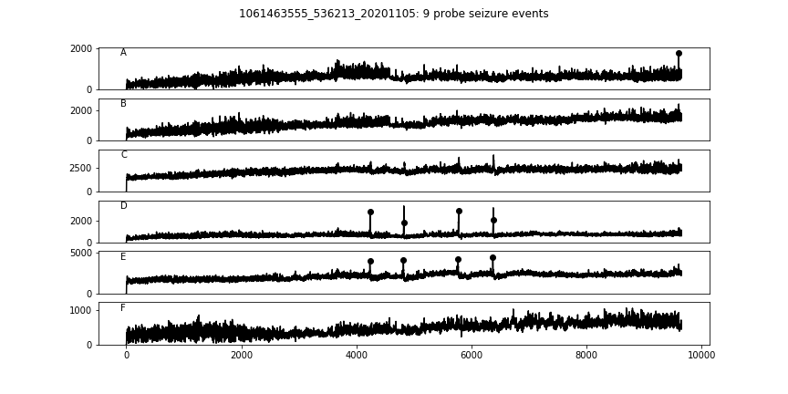
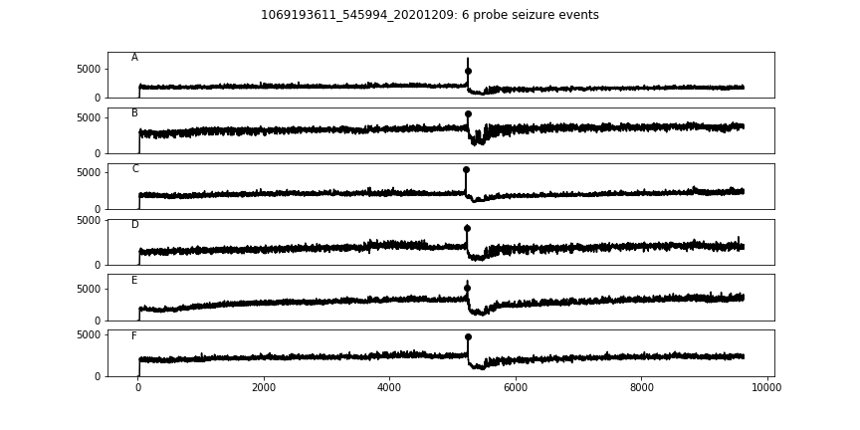
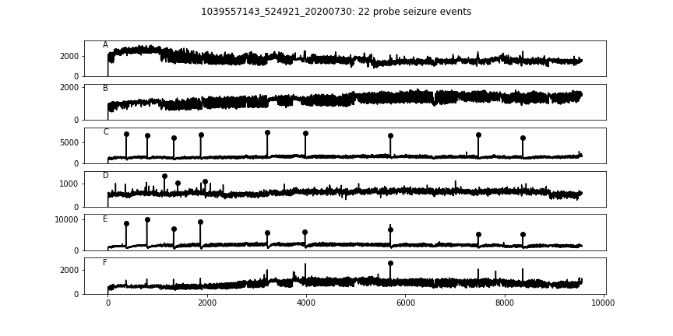
What do they look like - Variable

Slide 5
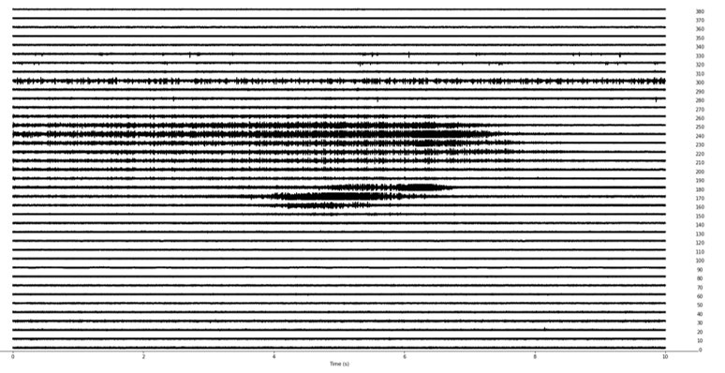
What do they look like – restricted to certain depths
This is our primary indicator that this is biological and not motion artifact or electrical artifact
(Motion artifact could also induce a rebound of the baseline spike rate)

Slide 6
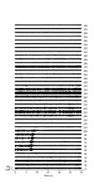
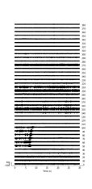
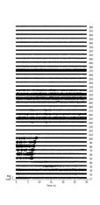
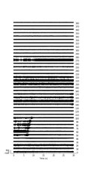
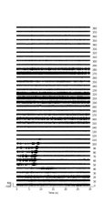
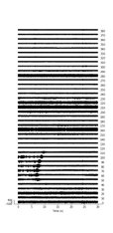

What do they look like - Repetitive
But this must not always be true given that some events occur on different subsets of probes

Slide 7
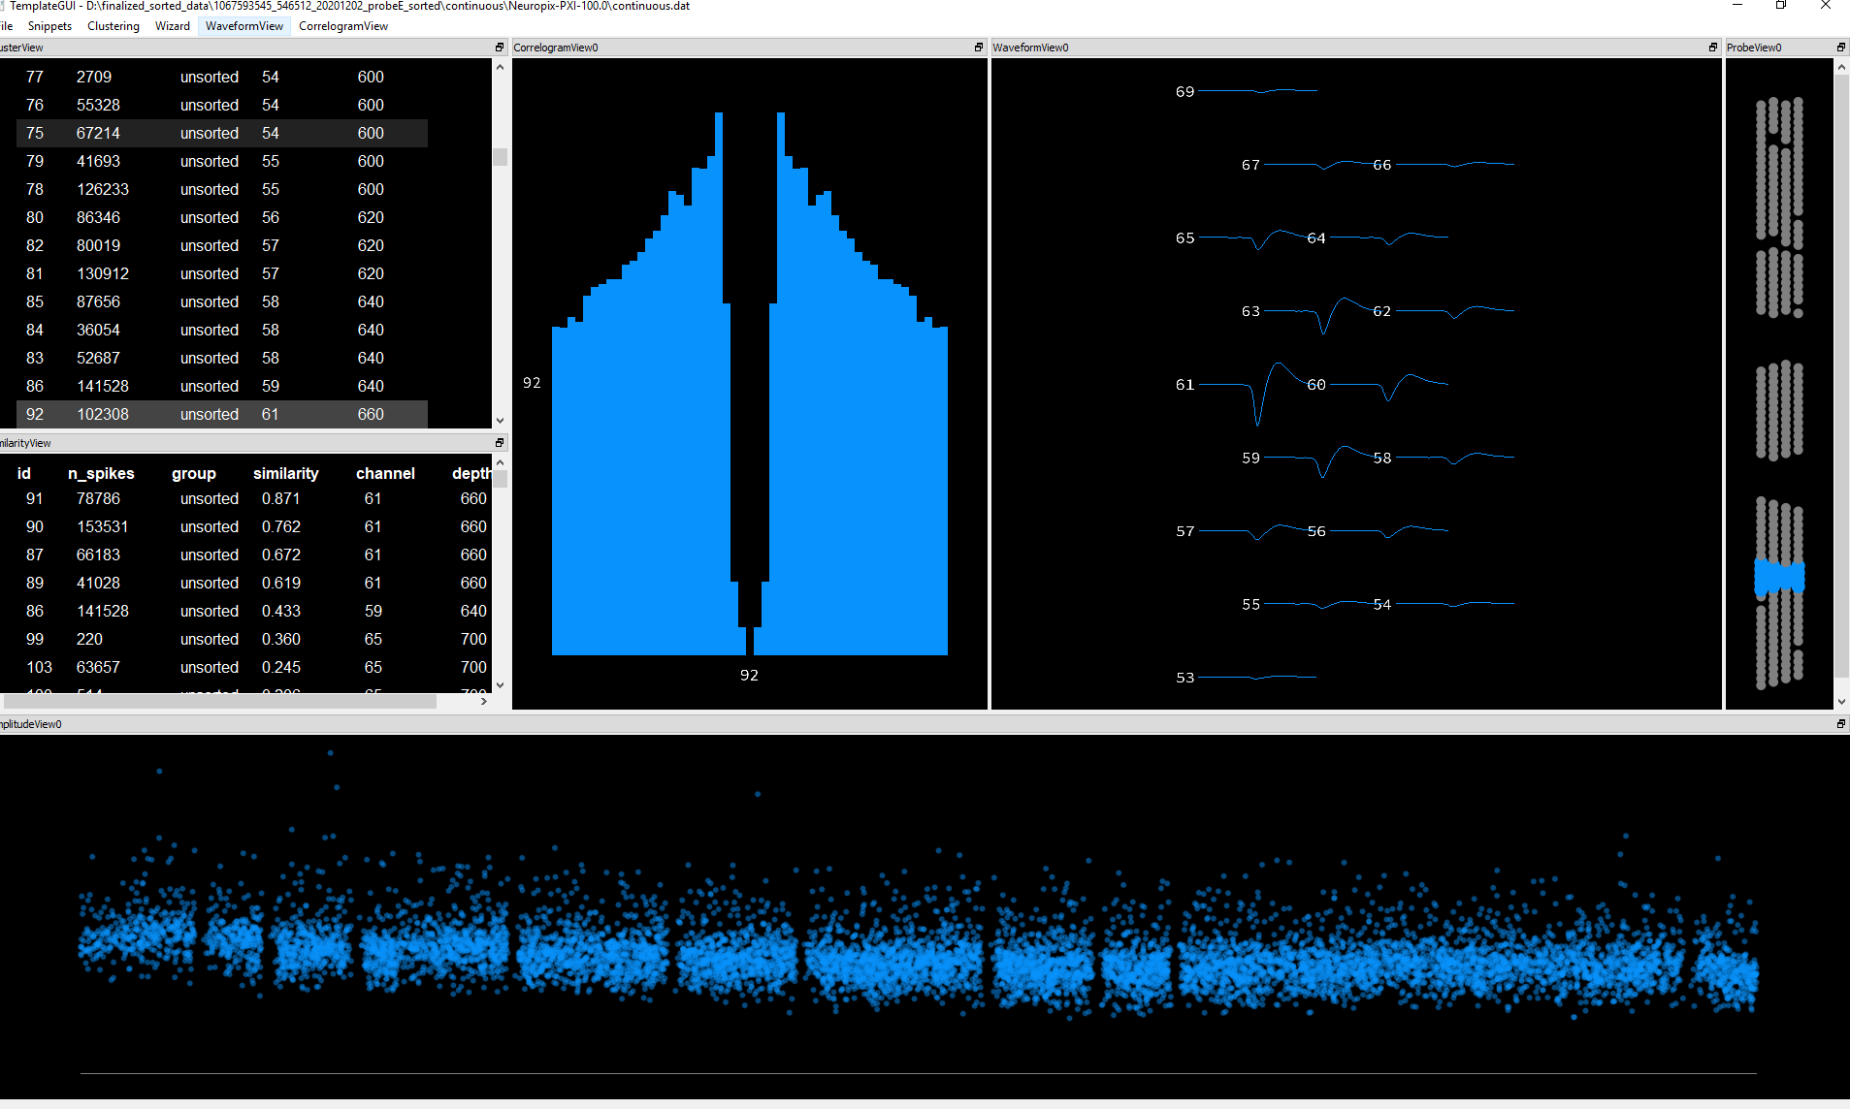
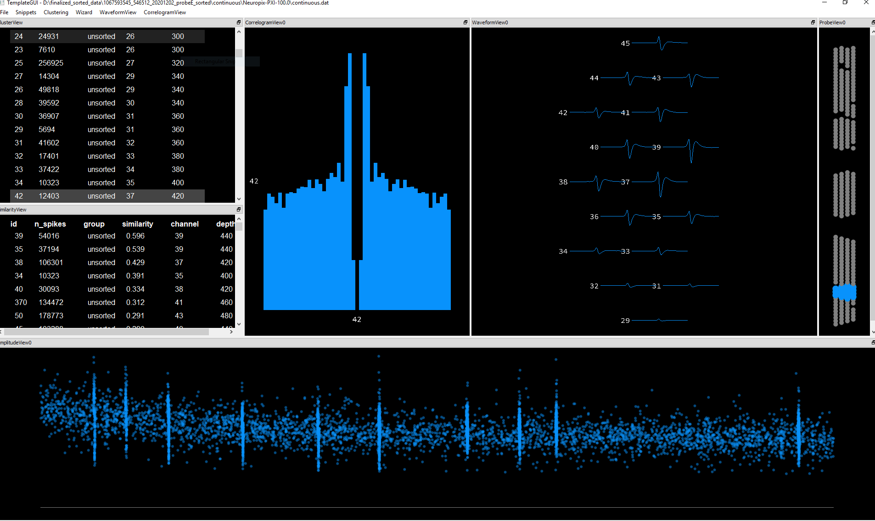
What do they look like - Phy
Difference between NS and RS?

Slide 8
What do they look like - LFP
Witnessed online 3x for one mouse (confirmed post hoc) – Large event, High frequency relative to normal LFP,
followed by saturation as best I can recall (likely display not amplifiers)
Then very quiet
Before returning to baseline (id the area I was watching was not normally completely quiet)
"large event followed by flatish LFPs" - Dan D

Slide 9
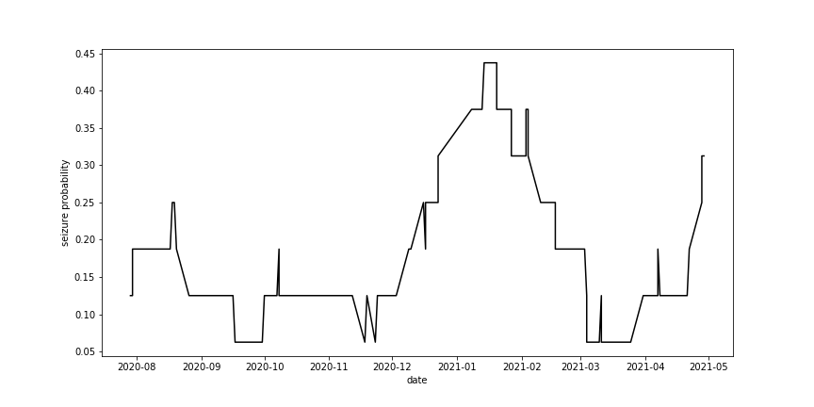
Wen have they happened?

Slide 10
What do they look like - Followup characterization
Percentage of units involved
Split by RS/NS/Opto-tagged
Split by depth (putative Ctx/Hippocampus/Deep)
Look at waveforms during the event and recovery
LFP – classification may be easier, size estimate may be more accurate, are there any that don't show in the spiking?

Slide 11
Framework for theories
1. Something is causing the mice to develop epilepsy before they reach us
2. Insertion of the probes causes leads to seizures
3. Something electrical causes the seizures during the experiment
Threshold Theory – 1+2/1+environmental change
1+3
2+3?
1 masquerading as a 2 or 3 (happens during habs in 325 or surgery/recovery)
With each of these possibilities I think it will be helpful to think about how to differentiate them from each other?
Which mice would we expect the seizures to occur in?
Would we expect to detect all of them or could they be happening and be undetected?
Would they always happen in the same place?
Would we expect them to vary in size?
Would we expect to see multiple? Or just one?
Would we expect to see them evenly throughout the session? Or in a stress/task/insertion dependent distribution?
Difference between Day1 and Day2?

Slide 12
Theory 1: Developing epilepsy
How can we distinguish this from the other two?
Look for seizures in mice that do not undergo the full neuropixels experiment
Try to find a causative factor that has changed

Slide 13
Theory 1: Developing epilepsy
Visual coding (~200)
Corbett and Sam's Pilot (17)
Design and Build phase (~8?)
Any mice that received surgery prior to March 2020 (15)
Caveat: Confound of water restriction and age (S&C, D&B and pre-covid mice were 200+)

Slide 14
Theory 1: Developing epilepsy
Visual coding (~200)
Corbett and Sam's Pilot (17)
Design and Build phase (~8?)
Any mice that received surgery prior to March 2020 (15)
Caveat: Confound of water restriction and age (S&C, D&B and pre-covid mice were 200+)
Supporting evidence:
No evidence of seizures in past pipeline animals

Slide 15
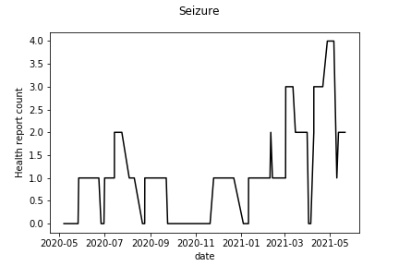
Theory 1: Developing epilepsy
Supporting evidence: Increased Seizure rate outside of experiments

Slide 16
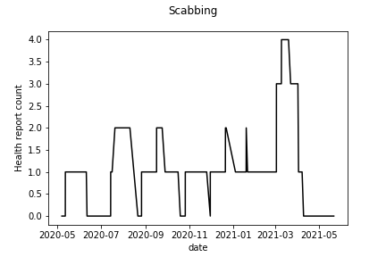
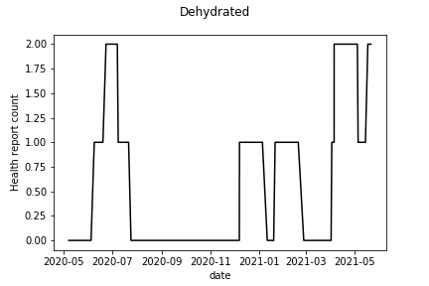
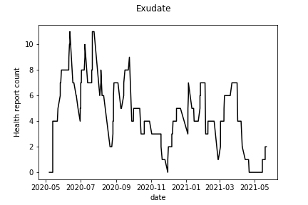
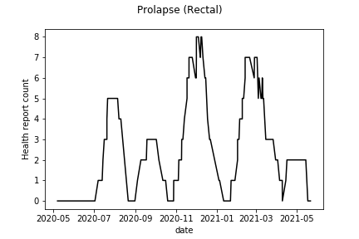
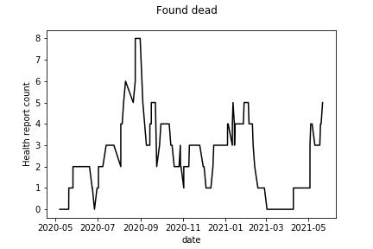
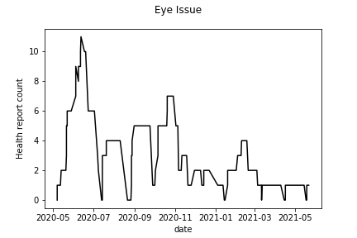
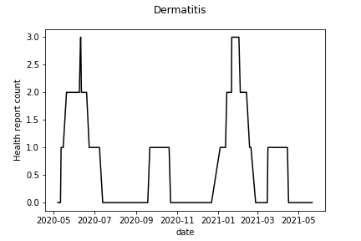
Theory 1: Developing epilepsy
Supporting evidence: Increased Seizure rate outside of experiments

Slide 17
Theory 1: Developing epilepsy
Supporting evidence: Increased Seizure rate outside of experiments
Limitations:
Seems to lag behind – we would actually expect it to preceed our rates
Aren't sure if this is a detection bias
Haven't seen anything unusual in Ophys/Leslie/Ethan/Ultra mice as far as we know

Slide 18
Theory 1: Developing epilepsy
Supporting evidence: Seizure rate across lines
Seems to be worst in SSTs and best in C57s
We would expect any health related issue to affect trangenics more
Caveat: It is difficult to interpret differences in line because of their uneven distribution in time

Slide 19
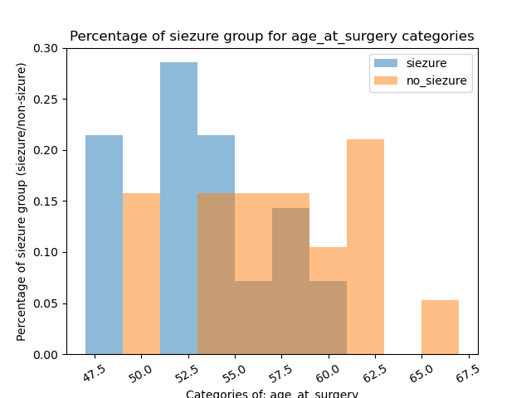
Theory 1: Developing epilepsy
Supporting Evidence: Age at Surgery

Slide 20
Theory 1: Developing epilepsy
Supporting:
lack in VC mice,
Lack in previous behavior mice
Presence during behavior training – seems to be increasing
rate in C57s vs VIPs vs SSTs
age at surgery
Maybe against:
Variability in location
Never happens on both experiment days
time during the session (settle data?)
Against:
lack in eslie, ethan, ultra mice
rate in ohpys mice?
Bias day1 > day2

Slide 21
Theory 1: Developing epilepsy
What can we look for?
Check more thuroughly in ophys mice
Continue shallow insertions
Look for changes at different points in the pipeline
More factor analysis

Slide 22
Theory 2: Probe insertion
How can we distinguish this from the other 2?
Bleeding
seizure rate should correlate with evidence of bleeding
mainly on our rig, with no increase outside the experiment, or drastically more common on our rig
Damage to a specific area
Only during experiment
Should see this in OPT

Slide 23
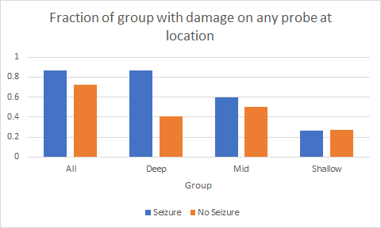
Theory 2: Probe insertion
Supporting Evidence:
Correlation with deep damage/bleeding

Slide 24
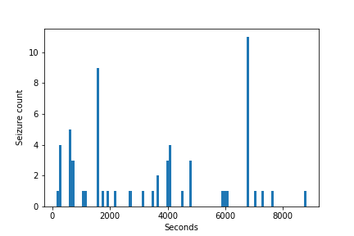
Theory 2: Probe insertion
Supporting Evidence:
Time during session

Slide 25
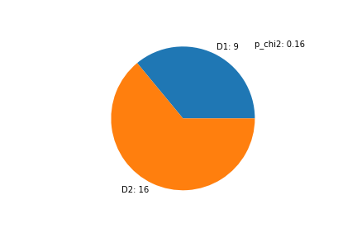
Theory 2: Probe insertion
Supporting Evidence:
Bias Day1 > Day2

Slide 26
Theory 2: Probe insertion
Supporting evidence: Variability in location
Mainly Supports bleeding, not specific structure

Slide 27
Theory 2: Probe insertion
Supporting Evidence:
Bias Day1 < Day2

Slide 28
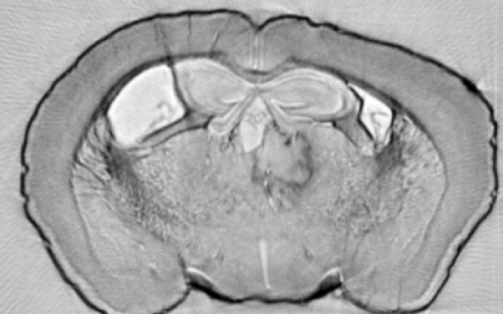
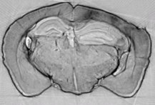
Theory 2: Probe insertion
Thalamic ‘blob’ 10/12 with seizures
Maybe Supporting Evidence:
Anatomical anomalies
Always on window side
Enlarged Hippocampus 4/4 with seizures

Slide 29
Theory 2: Probe insertion
Supporting Evidence:
Correlation with deep bleeding
Time during the session
Bias day1 < day2
Variability in location
Present (N =2) in a nick steinmetz Visual Cortex insertion
Dan denman saw them – associated them with Stress
Maybe Supporting:
Anatomy - thalamus blob, enlarged hippocampus, divots
Never happens on both days
Against:
didn't see it in the past. Something must have changed and we can't figure out what.

Slide 30
Theory 2: Probe insertion
What can we look for?
Changes in the probes (sharp/unsharp, New/Old)
Changes/variation in probe insertion depth, location or angle
RL location
Probe F shimming
Look in opt for what structures the probes pass through – any that we rarly hit before?

Slide 31
Theory 3: something electrical
This ones the most far fetched, but is motivated by some things we don't fully inderstand
.5V difference between OPT box/wall ground and mouse. Another PI who observd seizures thought this was problematic
Depth death occurs after some time and appears to be contagious – requires headstage replacement
We never figured out what was causeint the amplifier "blackout" in VC when we were in extreference – could be that there is some buildup that needs to dissapate, and it does so in a different way in tip reference
Might be dependant on where the tips are?
What was causing the lick artifact and why does a nonconductive surface solve it?
How can we distinguish this from the other 2?
Only on the rig (similar to 2)
Except would not necessarily correlate with bleeding
I would expect theat we ALWAYS detect these. Although this is not guaranteed I suppose.

Slide 32
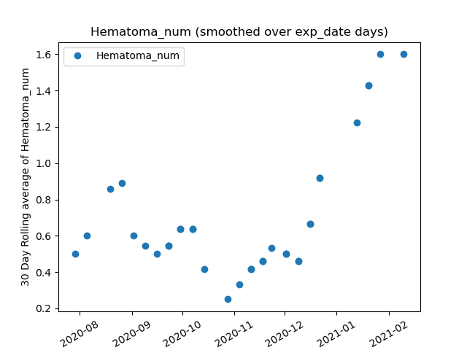
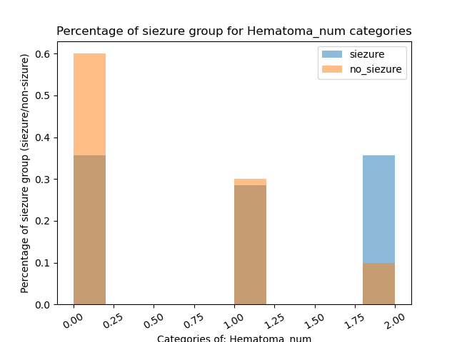
Threshold theory
Supporting evidence:
Hematoma

Slide 33
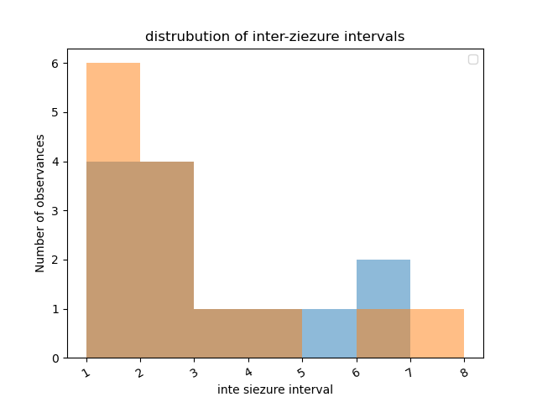
Theory 3: something Electrical
Contrary evidence:
Distribution of non-seizure intervals

Slide 34
Theory 2: Something Electrical
Supporting Evidence:
Most others who have seen them have been multi-probe neuropixels users
Maybe against:
Most of the supporting evidence for the previous theories
Never happens on both days
time during the session
Against electrical:
Distribution over time
Bias day1/day2
Variability in location
Distrubution of inter-seizure intervals

Slide 35
Theory 3: something electrical
What can we look for?
Changes in the rig
Probes
Headstages
Lickspout
Grounding wires

Slide 36
Other options
1 masquerading as a 2 or 3
We cause epilepsy after handoff, but its not due to beleding, damage or electrical
Ammonia, surgical window implantation, temperature, change in dehydration, stress of experiment
Look for:
Changes in these procedures

Slide 37
Biggest Clues:
Other Evidence:
Two severely dehydrated mice had seizures – Really bad ones too I believe?
Connection with Dura/bleeding during window removal?

Slide 38
Timeline of events
Our seisures, Wellness report seizures
Humidifier, High ammonia, airflow change, reduced bedding, cage change rate reduced
Down HVAC system
Cage changes
Sharpened probes, new probes, new headstages, NP3 cartridge
RL targeting, probe F Angle
Lickspout changes
Hematoma, divots
cutains jan 2020
any hvac issues (could affect air out through the ducts - are these disconected? 2/16 - 4/9 or 4/24 when replaced, unclear if there were undetected issues before this.
removal of NP2, so one of them isn't direct anymore, , - 1/15 2021
addiitons of synologies (adds heat source to room?)
addition of face cam -NP1 as soon as we got back in june, it had face cam, NP0 - june 30th started using and it had face cam
Started kwik-casting the agarose holes
Switched all mice to 3ul
lickspouts accurate? New lickspouts? MPE solonoid calibration
Brief ACSF filter change
New agarose mixtures
Changed image set (we have 1 seizure in an H mouse though)
Dipping probes in water
Careful adjustment of bumping
Sev gone (keeping mouse in room)

Slide 39
Timeline of a mouses life
Birth
Genotyping (tail snip)
Weaning
Group housing?
Surgery (P45-60?)
Recovery
ISI
Baseline weight established
Water restriction
Behavior training
Habituation
Insertino window implantation
Experiments

Slide 40
Interventions
What have we tried to rule out
What else could we try?
heating pad/water bath temp
ACSF, agarose powder
lickspout material – may merit more analysis?
sharpened/unsharpened
6 new probes - but then agarose calibrated?
Groudning to PXI box
extra settle time
working on:
depth of insertion?
ammonia and being kept out of cage
plastic window adhesive
Cleaning the rigs better
6 new headstages/probes
Probe F in a differnet place
Non-water restricted mice

Slide 41
Possible directions that require more work than inclusion of an additional factor
Can we identify them in habs/ophys?
Pupil size? Running/behavior anomalies (machine learned?)
Deep dive into the most serious ones, or the C57s
Start using severity instead of seizure/no seizure
Hard to quantify severity rigorously right now
Online or immediate seizure analysis – slice promptly after?
Could sor the settle data while the experiment is occuring. I'm going to try this this week
Anything else we could do if we ID seizure psitive? Wait longer? Try to deliver water in distributed chunks to see if that is connected
Measure potential between OPT and mouse on NP4
Probe F location on OPT and surface
Behavior – slight decrease in performance? Seems like we should assess this before data release
LFP – What do these look like? can we determine size of area affected? Can we detect seizures that did not affect the unit activity?

Slide 42
Factors with negative results so far
surgeon
Surgery damage
Genotype (ish?)
Baseline weight
daily water normalized by basline weight
Ages/time between pipeline steps *(other than age at surgery)
Number of habs (after handoff)
Compression
Opt damage

Slide 43
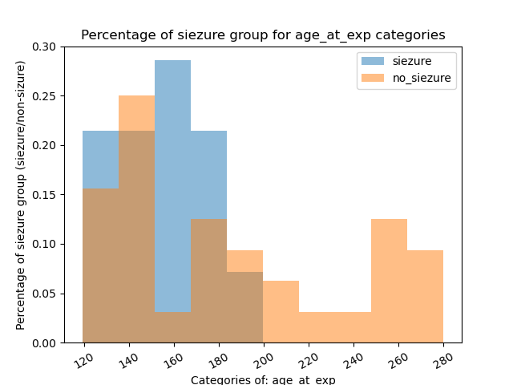
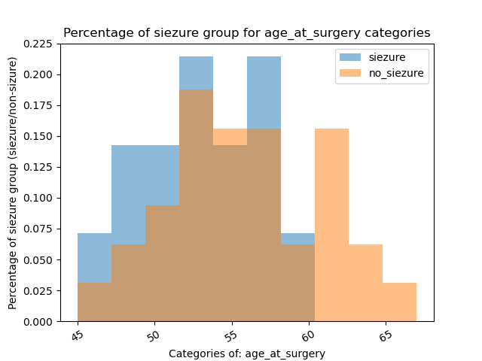
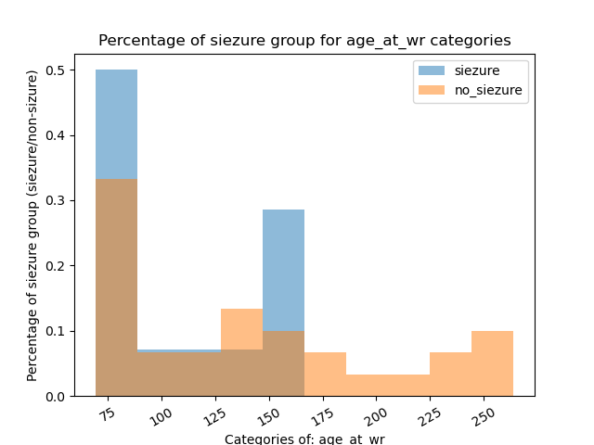
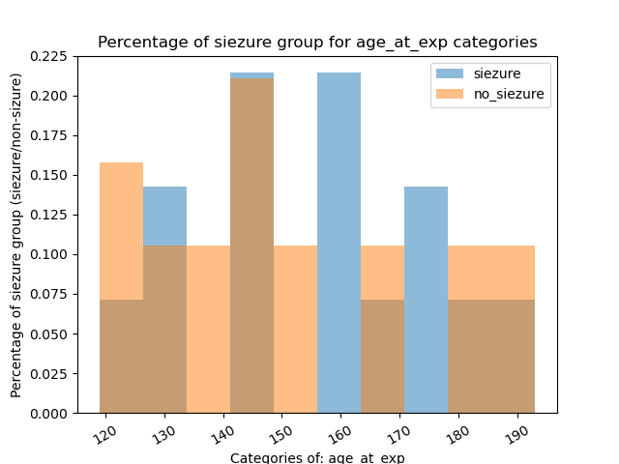
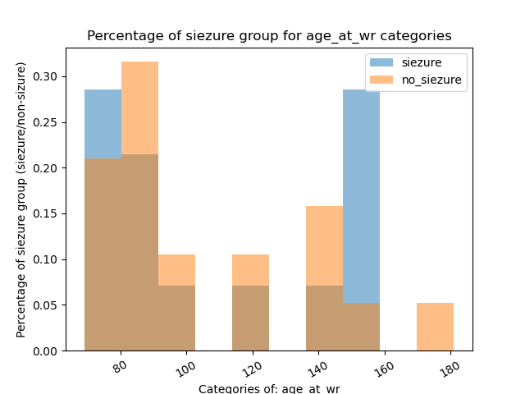
Negative Results

Slide 44
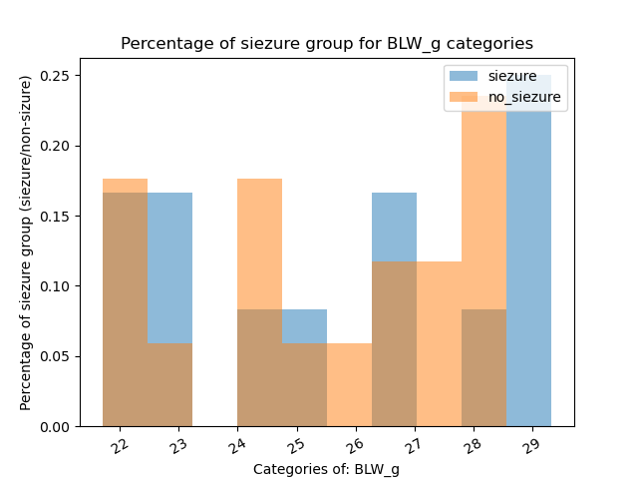
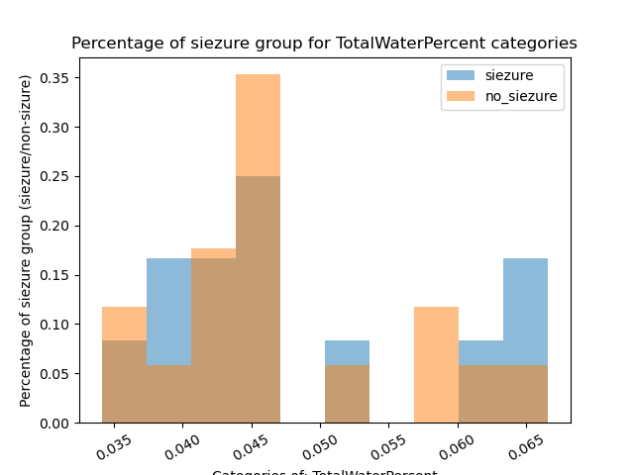
Negative Results

Slide 45
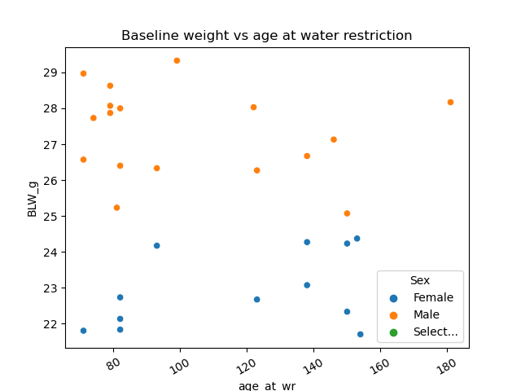
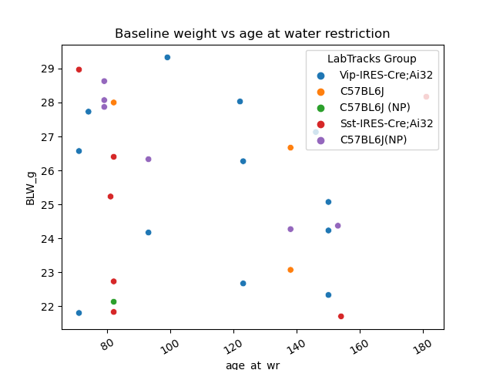
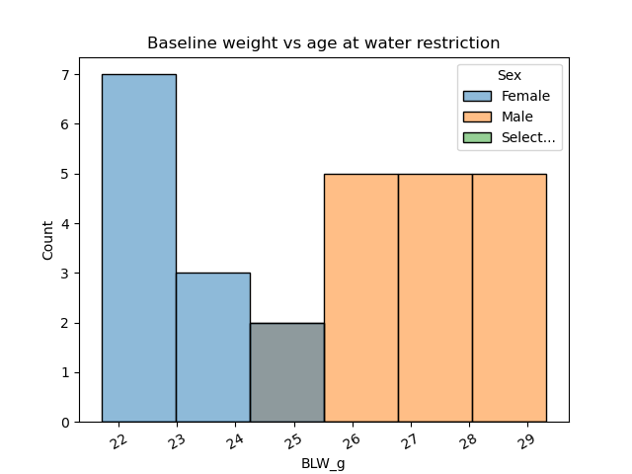
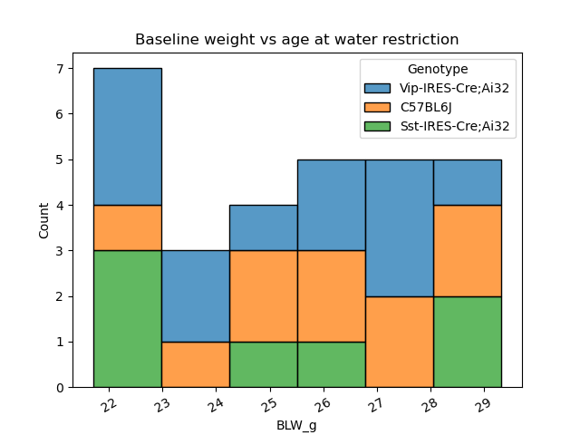
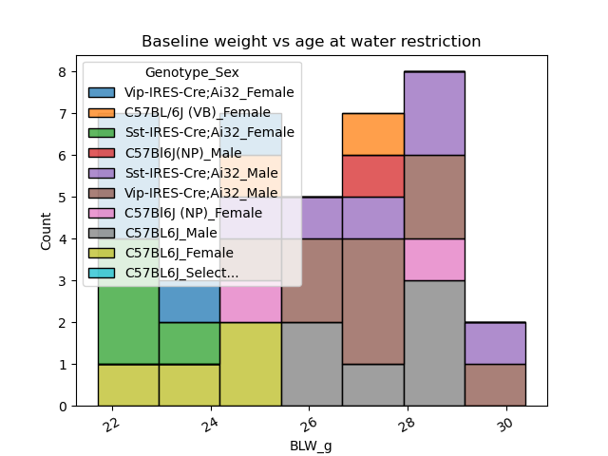
Negative Results

Slide 46
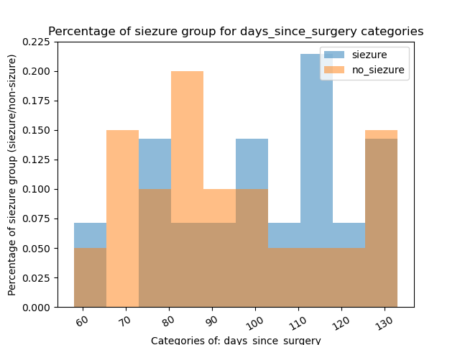
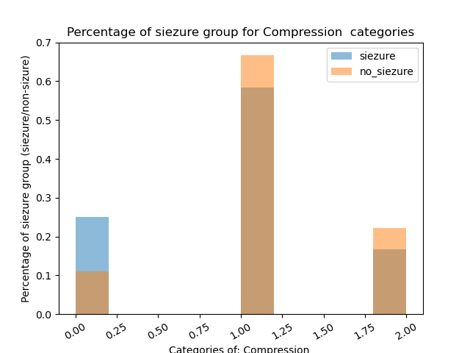
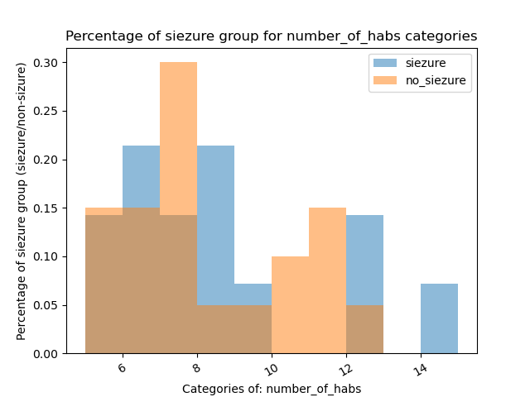
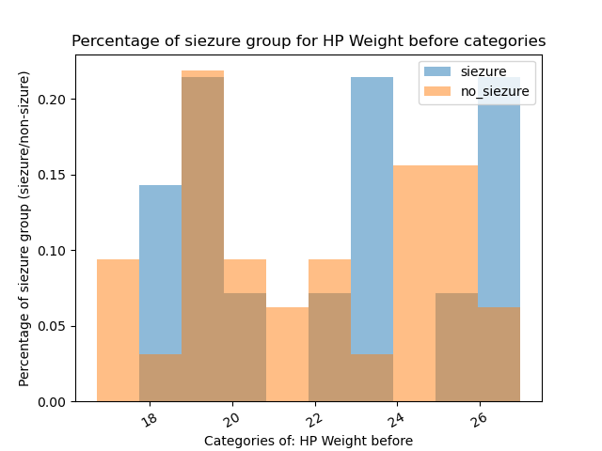
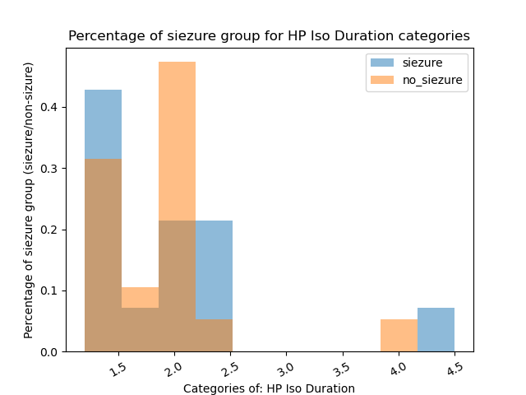
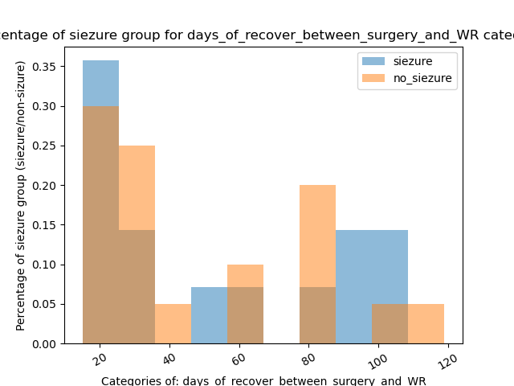




Negative Results

Slide 47
rate in C57s vs VIPs vs SSTs
What does this tell us?
Could give insight into whether some of the fluctuations are from changes in the rate of trangenics or real underlying changes over time
Tells us whether SSTs really Are worse and C57s really are better

Slide 48
No seizures: visual coding
Seems to indicate that 6 probes alone are not sufficient
Water restriction may be a significant change

Slide 49
No seizures: Previous behavior animals
Seems to indicate that 6 probes alone, and water restriction and behavior are not alone sufficient for seizures

Slide 50
No Seizures: Leslie and ethan mice
something in the colony (like an infection) is not alone sufficent
(different surgeon, prep, insertion location, stim etc)

Slide 51
Rate in ophys mice/our mice during training
Seems to indicate that something is happening before the mice get to us that makes them predisposed to seizures

Slide 52
Observation N=1 from nick stienmetze
Seems to indicate that the location of insertion (visual cortex) matters
Was this mouse water restricted? Sharpened probe? How deep?
Observed in any other mice? Has he checked?

Slide 53
Time during session
Seems to be biased towards the beginning of the session
Suggests that it is related to something that happens at the beginning or changes throughout the session
insertio

Slide 54
Thalamus blobs/swollen hippocampus
7/9 had seizures
Alsways on the insertion side
This implies it is either due to the window implantation
In which case we should see it in ophys mice/sahars mice
Or due to the probe insertion
In which case we should not see them in shallow insertions

Slide 55
Hydroencephalopothy? Enlarged ventricles?
X/X had seizures
Tends to be on opposite side? I think we saw this in VC sometimes too – might be due to window implant/headpost?

